Slide 1


SUBJECT- Seminar and Technical Communication
Department:- Information Technology
A
Seminar presentation
on
“ HELMET DETECTION WITH NUMBER PLATE RECOGNITION”
Prepared By
Mr. Saurabh Umesh Pisal
Exam Seat No.
Guided by
Prof. Sonali Dongare
PCET’S & NMVPM’S
NUTAN MAHARASHTRA INSTT. OF ENGG. & TECH. Pune
Academic Year 2023-24

Slide 2
SUBJECT- Seminar and Technical Communication
Department:- Information Technology
Contents
Introduction
Motivation
Objectives
Architecture
Methods/Different Methodologies
Scope of Work
Conclusion
References
Academic Year 2022-23

Slide 3
Introduction
In recent years, road safety and traffic management have become critical concerns for governments and societies worldwide. One of the most significant factors contributing to road safety is the strict enforcement of traffic regulations, including the mandatory use of helmets by motorcyclists and the accurate recognition of vehicle number plates. This seminar report discusses the implementation of a system that combines helmet detection and number plate recognition using advanced technologies such as computer vision and deep learning.

Slide 4
Motivation
The motivation behind this project is to enhance road safety and traffic management. Helmet detection helps in enforcing helmet-wearing rules, reducing head injuries in motorcycle accidents, and number plate recognition aids in monitoring and controlling traffic violations more effectively. This system can significantly contribute to reducing road accidents and improving traffic law enforcement.

Slide 5
Objectives
The primary objectives of this seminar report are:
To develop a robust helmet detection system using computer vision and deep learning techniques.
To implement an accurate and efficient number plate recognition system.
To integrate these systems to create a comprehensive solution for improved road safety and traffic management.

Slide 6
Architecture
The proposed architecture consists of two main components: the Helmet Detection Module and the Number Plate Recognition Module. The Helmet Detection Module employs convolutional neural networks (CNNs) for object detection and localization, while the Number Plate Recognition Module employs optical character recognition (OCR) algorithms for extracting text from images.

Slide 7
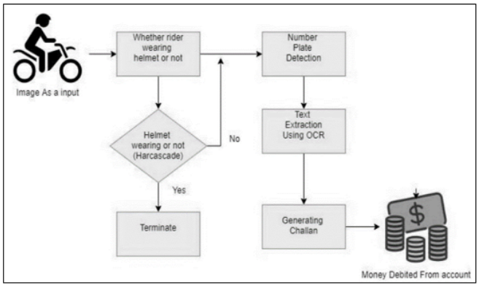

Slide 8
Methodology
Helmet Detection:
Utilizing pre-trained CNN models like YOLO (You Only Look Once) or Faster R-CNN for helmet detection.
Data augmentation techniques to improve model performance.
Real-time image processing and classification.
Number Plate Recognition:
Segmentation of the number plate region from the vehicle image.
Text extraction from the number plate using OCR techniques.
Post-processing steps for accurate character recognition.

Slide 9
Data Collection:
Collect a diverse dataset of images and videos containing motorcycles and vehicles with helmets and number plates.
Annotate the dataset to label helmet and number plate regions.
Preprocessing:
Image and video preprocessing to enhance image quality, remove noise, and standardize the data.
Helmet Detection Module:
Utilize a deep learning-based object detection model (e.g., YOLO or Faster R-CNN) for helmet detection.
Train the model using the annotated dataset.
Fine-tune the model on motorcycle helmet detection.
Post-processing for filtering and refining helmet detection results (e.g., non-maximum suppression).
Number Plate Recognition Module:
Number plate region localization using object detection or image segmentation techniques.
Text extraction from the number plate using Optical Character Recognition (OCR) algorithms (e.g., Tesseract).
Post-processing to refine and correct recognized characters.
Integration:
Combine the outputs of the Helmet Detection and Number Plate Recognition modules into a single system.
Establish communication and data sharing between the modules.

Slide 10
Real-time Processing:
Implement real-time video streaming or image capture to continuously process incoming data from cameras and sources.
Ensure low-latency processing for immediate detection and recognition.
Alert and Notification System:
Implement an alert mechanism to trigger notifications when a helmet violation or number plate issue is detected.
Notify relevant authorities or stakeholders in real-time.
Database and Logging:
Store the recognized number plate data, violation details, and images or videos for auditing and evidence purposes.
User Interface:
Develop a user-friendly interface for administrators and law enforcement personnel to monitor and manage the system.
Display real-time alerts, violation reports, and access recorded data.
Scalability and Deployment:
Ensure the system can be easily deployed on various platforms, including edge devices and cloud servers.
Plan for scalability to accommodate a larger number of cameras and users.

Slide 11
Testing and Evaluation:
Conduct rigorous testing and evaluation of the system's performance in real-world scenarios.
Use metrics like accuracy, precision, recall, and processing speed to assess the system's effectiveness.
Maintenance and Updates:
Implement a maintenance plan to address hardware and software issues, update the model, and adapt to changing conditions or regulations.
Security and Privacy:
Ensure data security and privacy by encrypting data in transit and at rest.
Comply with relevant data protection regulations.
Documentation and Training:
Create comprehensive documentation for system installation, configuration, and operation.
Provide training to system administrators and operators.
Feedback and Improvement:
Continuously collect feedback from users and stakeholders to make improvements to the system, update the model, and adapt to new challenges.
This architecture provides a high-level overview of the components and processes involved in building a system for Helmet Detection and Number Plate Recognition. The specific technologies and tools used may vary based on the project's requirements and available resources.

Slide 12
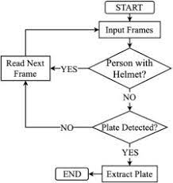

Slide 13
Scope
The scope of this work extends to the following areas:
Real-time helmet detection and number plate recognition on a variety of vehicles.
Integration with surveillance cameras and traffic monitoring systems.
Implementation of an alert system for violations, sending notifications to authorities.
Potential for future enhancements, such as vehicle type recognition, color recognition, and traffic congestion monitoring.

Slide 14
Conclusion
In conclusion, the integration of helmet detection and number plate recognition systems using advanced technologies can significantly contribute to road safety and traffic management. The successful implementation of these systems can lead to reduced traffic violations, improved law enforcement, and a safer environment for both motorists and pedestrians. The scope of this work is vast and can be expanded to address additional challenges in road safety and traffic management.

Slide 15
References
[1] R. R. V. e. Silva, K. R. T. Aires and R. d. M. S. Veras, “Helmet Detection on Motorcyclists Using Image Descriptors and Classifiers,” 2014 27th SIBGRAPI Conference on Graphics, Patterns and Images, Rio de Janeiro, 2014, pp. 141- 148.
[2] Li, J., Liu, H., Wang, T., Jiang, M., Wang, S., Li, K., Zhao, X. (2017, February). Safety helmet wearing detection based on image processing and machine learning. In Advanced Computational Intelligence (ICACI), 2017 Ninth International Conference on (pp. 201-205). IEEE.
[3] K. Dahiya, D. Singh and C. K. Mohan “Automatic detection of bike-riders without helmet using surveillance videos in real-time,” 2016 International Joint Conference on Neural Networks (IJCNN), Vancouver, BC, 2016, pp. 3046- 3051
[4] C. Vishnu, D. Singh, C. K. Mohan and S. Babu, “Detection of motorcyclists without helmet in videos using convolutional neural network,” 2017 International Joint Conference on Neural Networks (IJCNN), Anchorage, AK, 2017, pp. 3036- 3041.

Slide 16
SUBJECT- Seminar and Technical Communication
Department:- Information Technology
Thank You
Academic Year 2023-24

